Slide 1
A Seminar on Investigation and Finding A DNA Cryptography layer for Securing data in Spark Cluster
Team Details
Rettala Nikhil Goud(20EG105317)
Kadiyala Venkat Sathwik(20EG105319)
Kandula Akshaya(20EG105322)
Project Supervisor
Dr. J Balaraju
M.Tech.,Ph.D
Assistant Professor

Slide 2
Introduction
Spark is fitting for dealing with efficient in storage and analysis of data and it has certain security issues with the usage of third party security for authentication which used huge computations in all the versions of Spark. This desired method is a new security mechanism as single security instance, a SEAL (Spark E-Authentication Layer) as a secure layer which positioned above the Spark Cluster.
What is essential?
This developed protocol SEAL is providing security using fewer computations, unlike integrating a third-party authentication protocol like Kerberos. This authentication step ensures that only users possessing the correct unique DNA key, received through email, are granted access to Apache Spark for distributed data processing.

Slide 3
Problem Statement
1.Problem statement
Apache Spark uses third party security which used huge computations in all the versions of Spark. Many Spark Clusters are configured with Kerberos for user authentication. Node identification is very important to start spark daemons for efficient running of spark cluster and it is not possible to start daemons with duplicate hostnames.
Existing method(s) disadvantages
The primary existing problem in user authentication within spark is the reliance on third-party security measures, such as Kerberos, which introduces computational overhead. The fragmented nature of security capabilities, developed independently, complicates user authentication and access control.
Users face challenges in securing their data, particularly in the absence of a unified security mechanism. The need for a single security instance for user authentication becomes apparent to address these existing authentication issues in spark.

Slide 4
Problem Illustration
Consider a scenario where multiple users attempt to access and interact with data stored in a Spark Cluster. In the current setup, the user authentication process relies on third-party security protocols, such as Kerberos.
1. Fragmented Authentication Mechanisms:
The illustration depicts different users (User A, User B, and User C) attempting to authenticate through various security mechanisms.
User A encounters authentication through Kerberos, while User B goes through a different process.
This fragmentation in authentication mechanisms complicates the overall security landscape, making it challenging to maintain a cohesive and standardized approach.
2. Computational Overhead:
Each user's authentication involves multiple computational steps and interactions with external authentication services.
This process introduces computational overhead, as illustrated by the intricate network of calculations and verifications

Slide 5
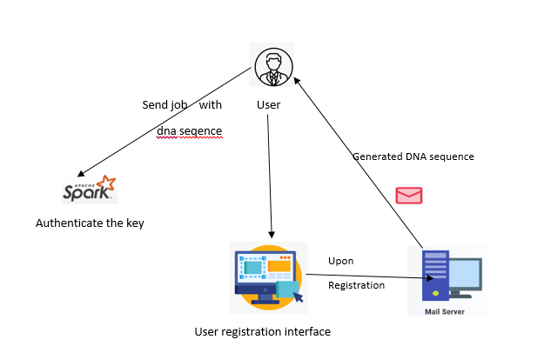
Proposed Method
The proposed project aims to develop a secure user authentication system that leverages a unique DNA sequence generated from user-provided email and username. This DNA sequence is sent to the user's email for authentication.
The Spark job serves as authentication with unique id as a argument, ensuring that only authorized users with the correct Unique key can access and contribute to the Spark cluster.

Slide 6
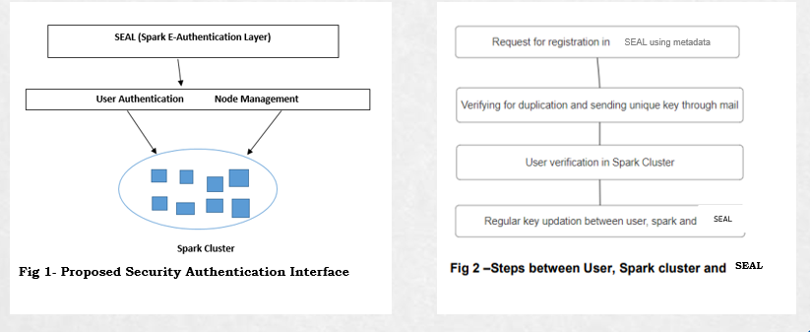
Proposed Method

Slide 7
Experiment Environment
Software Requirements:
Operating System : Linux(Ubuntu)
Latest version of VSCode 1.60.0. Apache Spark (Latest Version) and NodeJS (Version 18.8.1).
ExpressJS (version 4.18.2) library has been included to harness its capabilities for building a robust and responsive webserver.
Nodemailer(3.0.3) module for Node.js that is used for sending emails.
Hardware Requirements:
Processor: Intel Core i5/i5-2350M CPU @2.30GHz.
RAM Capacity: 4 GB RAM or more.
System Type: 64-bit Operating System.

Slide 8
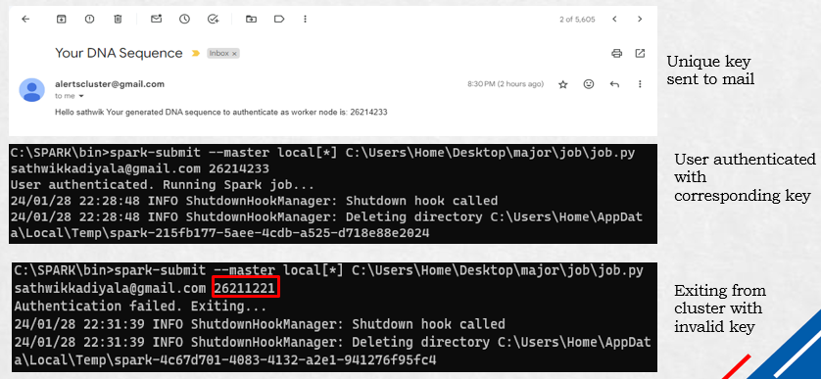
Experiment Screen shots

Slide 9
Experiment Results
Metadata Security existing and proposed Mechanisms.
Number of times Updation Number of times Updation
Required(Existing) Required (Proposed)
User1 8 1
User2 16 2
User3 24 3
The above table is showing for 3 Spark salve nodes metadata information existing which is updating every 8 seconds, but the proposed security mechanism can update every 64 seconds for reducing the computational burdens.
Findings:
Reduces update frequency to every 64 seconds.
The proposed mechanisms demonstrate significant improvements in computational efficiency and metadata security.

Slide 10
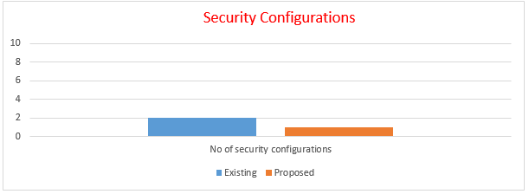
Experiment Results
Security Configurations existing and proposed
Findings:
Consolidates security into 1 configuration.
Eliminates metadata security computations.

Slide 11
Experiment Results
User Authentication computation
The following table showing the 10 users wants login single node cluster and the required to authentication by using Kerberos before entering the cluster. Every time they request KDC for each session which is taking 10 computation per session, each users may request authentication KDC depending on their usability of cluster.
No.of sessions Total Number of Time Total
Authentications/ Computations Authenticated/ Computations
Day (Existing) Day(Proposed)
User1 5 50 2 8
User2 10 100 3 12
User3 8 80 4 16
Total 23 230 9 36
Table shows the user sessions and total computations of existing and proposed authentication.

Slide 12
Finding
The experimental results indicate a substantial improvement in both computational efficiency and metadata security with the proposed mechanisms compared to the existing ones in the spark cluster environment.
Furthermore, the consolidation of security configurations into a single setup streamlines the user authentication process, significantly reducing the computational load required for each authentication instance.
This consolidation not only simplifies the authentication workflow but also enhances the overall system performance by minimizing redundant computations.
Overall, these findings underscore the efficacy of the proposed mechanisms in addressing key security and computational challenges inherent in spark clusters. By optimizing authentication processes and metadata management, the proposed approach offers a robust and efficient solution for securing big data environments while minimizing computational overhead, ultimately enhancing system performance and user satisfaction.

Slide 13
Justification
Parameter Formulas:
The current spark cluster security mechanism consumes
T(SC)=U[(6t)+x+y] +O(N)
The developed Spark Cluster security mechanism consumes
T(SAI)=U(5) +[O(N)+D]
Parameters improved:
Improves security by stopping and exiting spark job in the spark cluster thereby enhancing cluster security, data integrity and less computational user authentication.
How parameters are improved:
This is achieved through unique key generation methods, real-time monitoring, alerting mechanisms, and seamless integration with cluster management tools. These enhancements make the system highly effective in preventing node duplication, ensuring a secure and reliable cluster environment.

